Slide 1


IDMP and how we can support the health care domain
GInAS/GSRS meeting
November 16th, 2018

Slide 2



Outline of the Presentation
Ing. Ciska Matai, presenter CBG-MEB Quality Department, Substance & Medicinal Product Registration System
Drs. Herman Diederik, presenter CBG-MEB Operational Management Department, Scientific lead EU-Substance Registration System
The GInAS project, started in 2013
IDMP Suite; Set of 5 standards and 4 Technical Specifications finalised with the ISO Award 2018 on the 30th Plenary Meeting, October 2018, Paestum Italy. Scope of IDMP Substance Standard and Implementation Guide, which is key for unique Substance identification and good Substance management
Work in process on the future development of the ISO 11238 Substance Standard and ISO/TS 19844 Implementation Guide; Examples
GSRS software and Europe
Notes:
In addition to the set of standards there is ISO 14872 report” IDMP – Core Principles for Maintenance of Identifiers and Terms”

Slide 3
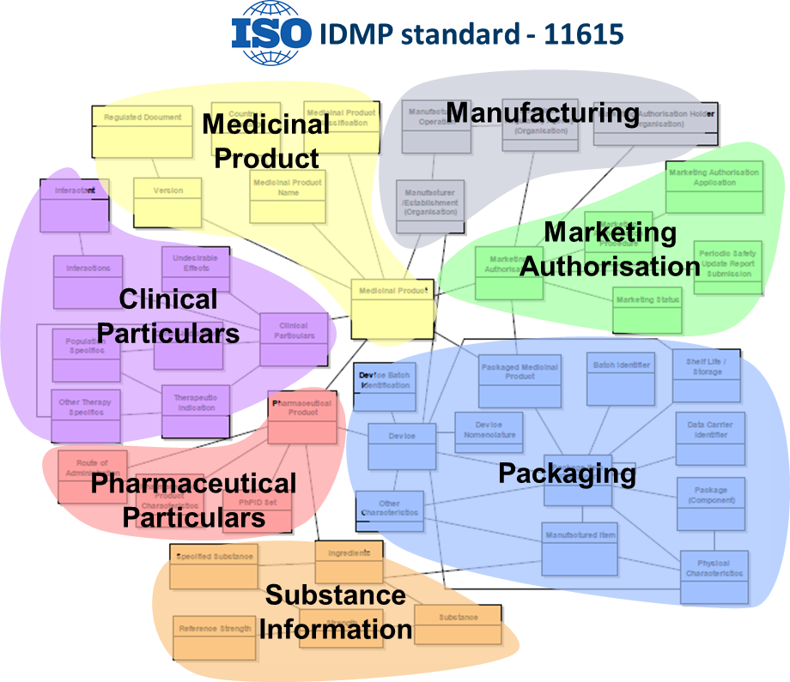
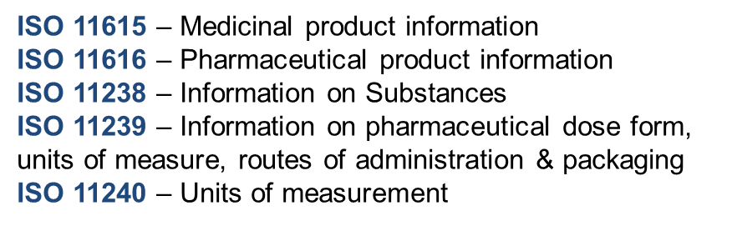
IDentification of Medicinal Products (IDMP) is a set of five ISO Standards and Technical specifications that enable the transition to structured product information
Introduction through legislation, regulators, but also for internal purposes
Provides structured medicinal, pharmaceutical product and substance data models
Provides mechanisms to uniquely identify products and its components
It is the only global standard for product information
Notes:
The IDMP standards and Technical specifications provide structured medicinal , pharmaceutical product and substance data models , mechanisms to uniquely identify products. It is the only global standard for product information. The grey block ‘Manufacturing’ reflects in general ‘Organisations’

Slide 4
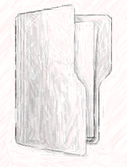
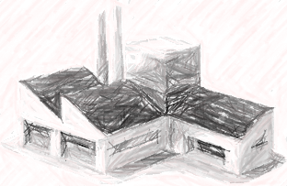


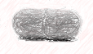

IDMP introduces identification numbers that enable communication
Dossier
Manufacturer
Pharmaceutical product
Packaged product
Pharmacy
Patient
MPID
(S)SID
PhPID
PCID
In case of adverse event
IDMP Identifiers
Individual Case Safety Report (ICSR)
E2B (R3)*
Good substance management depends on adequate substance and specified substance identifiers (S)SID
*Example of a use case of IDMP”
Notes:
IDMP introduces identification numbers that enable communication.
This example shows where the corresponding IDMP IDs are used in the use case pharmacovigilance.

Slide 5

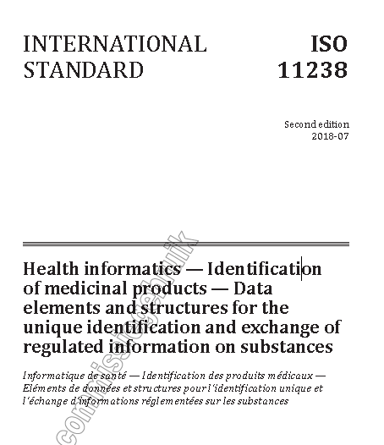
ISO 11238:2018 International Substance Standard, Published Editors: Herman Diederik (CBG-MEB), Lawrence Callahan (FDA), Frank Switzer (FDA), in cooperation with Panagiotis Telonis, (EMA)
Scope
This document provides an information model to define and identify substances within medicinal products or substances used for medicinal purposes, including dietary supplements, foods and cosmetics. The information model can be used in the human and veterinary domain since the principles are transferrable. Other standards and external terminological resources are referenced that are applicable to this document.

Slide 6
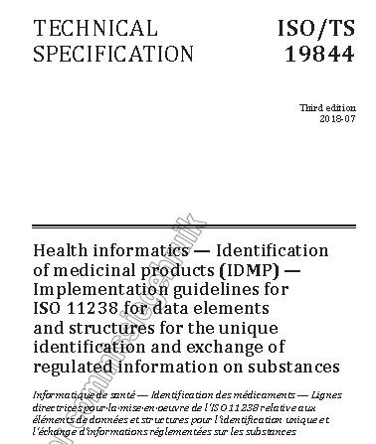
ISO/TS 19844 implementatie guide Editor: Herman Diederik (CBG-MEB) in cooperation with Panagiotis Telonis (EMA), Lawrence Callahan (FDA), Andrew Marr (BSI)
Scope
This document provides detailed explanations of each type or grouping of substance information, an element-by-element description for implementation of ISO 11238, and many examples for a variety of Substances and Specified Substances.
The third edition of the document addresses Substances Groups 1 to 3 of the Specified Substances as defined in ISO 11238 and Annexes A, B, C, D, E, F, G, H, I, J and K.
It is anticipated that Specified Substances Group 4, as defined in ISO 11238, will be addressed in a subsequent edition of this document. Some information that would typically fall under Specified Substances Group 4 is covered in the Annexes of this document. This information, although not exclusively defining of either a Substance or a Specified Substance Group 1, might be essential to distinguishing substances. This document addresses the following:
— data elements necessary for defining Substances and Specified Substances Groups 1 to 3;
— the logical use of data elements as defined in ISO 11238;
— Substances and Specified Substances Groups 1 to 3 business rules for:
- determining necessary data elements,
- distinguishing and defining materials according to ISO 11238,
- triggering the assignment of identifiers.

Slide 7

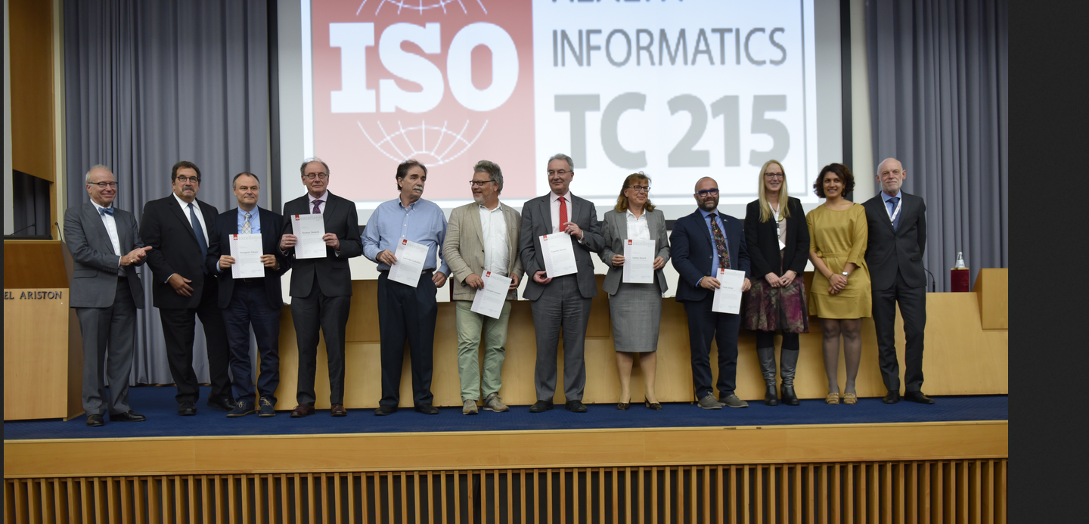

ISO Award Issued at the 30th Plenary Meeting, Paestum, Italy – October 22th
f.l.t.r: Christian Hay (ISO/TC 215, WG6 Convenor )-Michael Glickman(ISO/TC 215, Chair)-Panagiotis Telonis (EMA)-Herman Diederik (CBG-MEB)-Larry Callahan (FDA)-Christof Gessner (Gematik.de)-Tim Buxton (EMA)- Sabine Brosch (EMA)-Paolo Alcini (EMA)-Diana Warner (ISO/TC 215, Secretary)- Shirin Golyardi (NEN/Secretary ISO/TC 215, WG6)-Frits Elferink (KNMP, ISO/TC 215 WG6 Co-Convenor). Awardees not shown: Ilaria Del Seppia (EMA)- Vada Perkins (FDA)-Andrew Marr (BSI)- Chris Jarvis (EDQM).
International Organization for Standardization; When the world agrees

Slide 8
Why that level of detail of substances is necessary as provided in the Standard and Technical specification?
Unambiguously characterized substances according to ISO11238 and ISO/TS 19844
Unique substance ID’s and Specified Substance ID’s to be used in several use cases and regulatory processes
References, properties, methods and specifications in Regulatory documentation should be adequately covered in a structured way; - which implies sufficient detailed structured registration
- by use of sufficient detailed data model attributes
Notes:
At bullet point 3: There are cases, e.g. for Structurally diverse substances, that the definitional/ mandatory fields are not sufficient to distinguish the substances from each other.
Therefore conditional fields has to be taken into account. This means that much more fields/ attributes are involved and sometimes in combination e.g. Specified Substance Group 1 characteristic attributes and constituents having a limit specification e.g Herbal extracts.

Slide 9

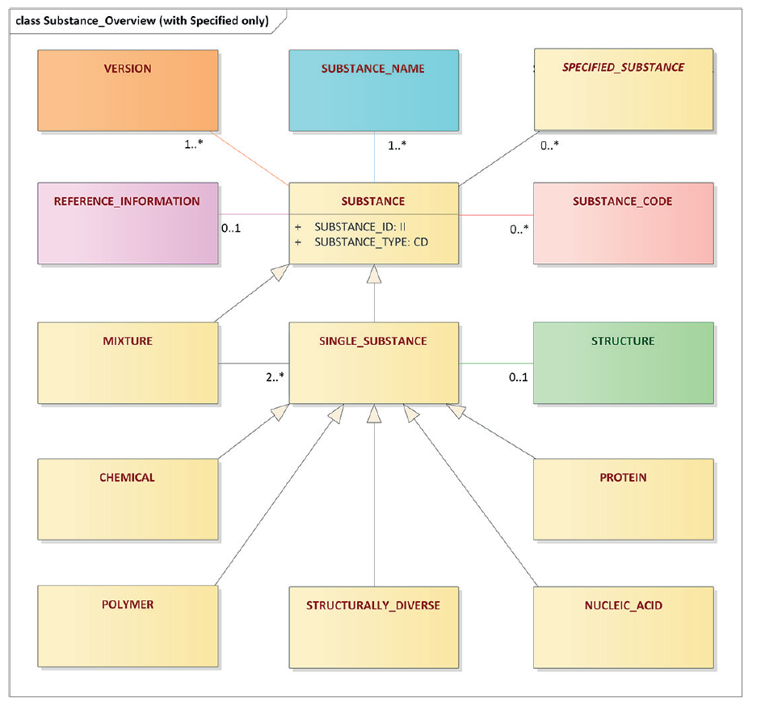
High-level information model of substances
TS 19844 Single substance types Annex:
B) Chemical;
C) Protein;
D) Nucleic Acid;
H) Polymer
E) Structurally Diverse Substance, Herbal;
F) Structurally Diverse Substance, Homeopathic;
G) Structurally Diverse Substance, Plasma-derived;
I) Structurally Diverse, Vaccines;
J) Structurally Diverse, Allergen and
K) Structurally Diverse, Advanced Therapies and Advanced Vaccines (Genes, Modified Viruses, Cells and Tissues as Substances)
Notes:
Substance class relationship: Version/ Name/ Code/ Specified Substance/ Reference information and Mixture; Single Substance Types: Chemical/ Protein/ Nucleic acid/Polymer / Structurally diverse and Structure or sequence relation.

Slide 10
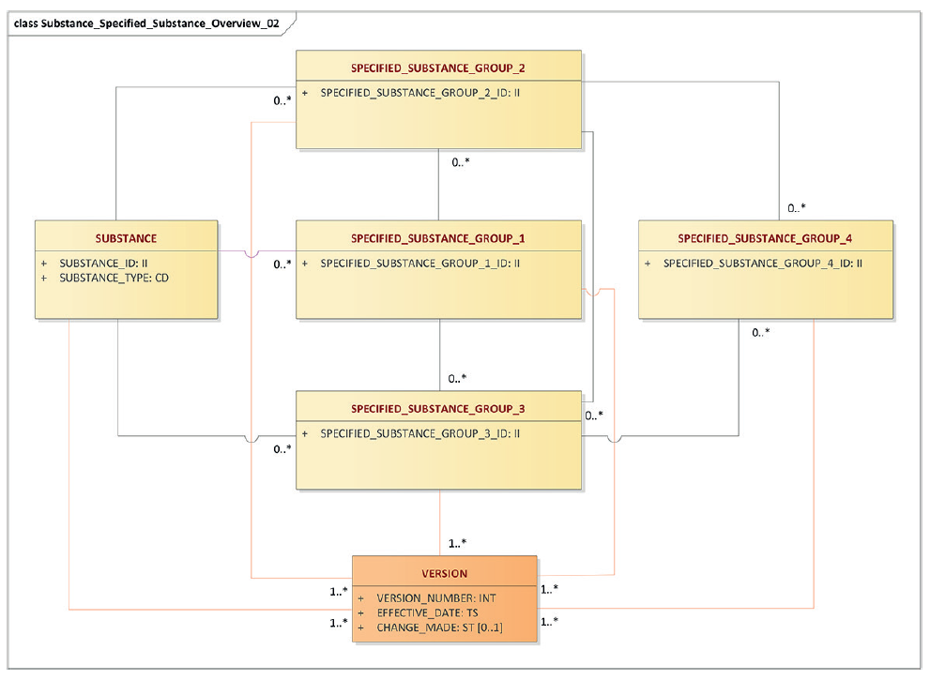
High-level Substance - Specified Substance Relationship
Notes:
Substance– Specified Substance relationship = Grouping of data elements in the Substance and Specified Substance Group 1,2,3 and 4 levels. Group 1 = additional information of the substance; Group 2 = Manufacturing information; Group 3 = In-House or Official reference source information e.g. pharmacopoeial information; Group 4 concerns detailed substance information like quality specifications, analytical and detailed manufacturing information.

Slide 11
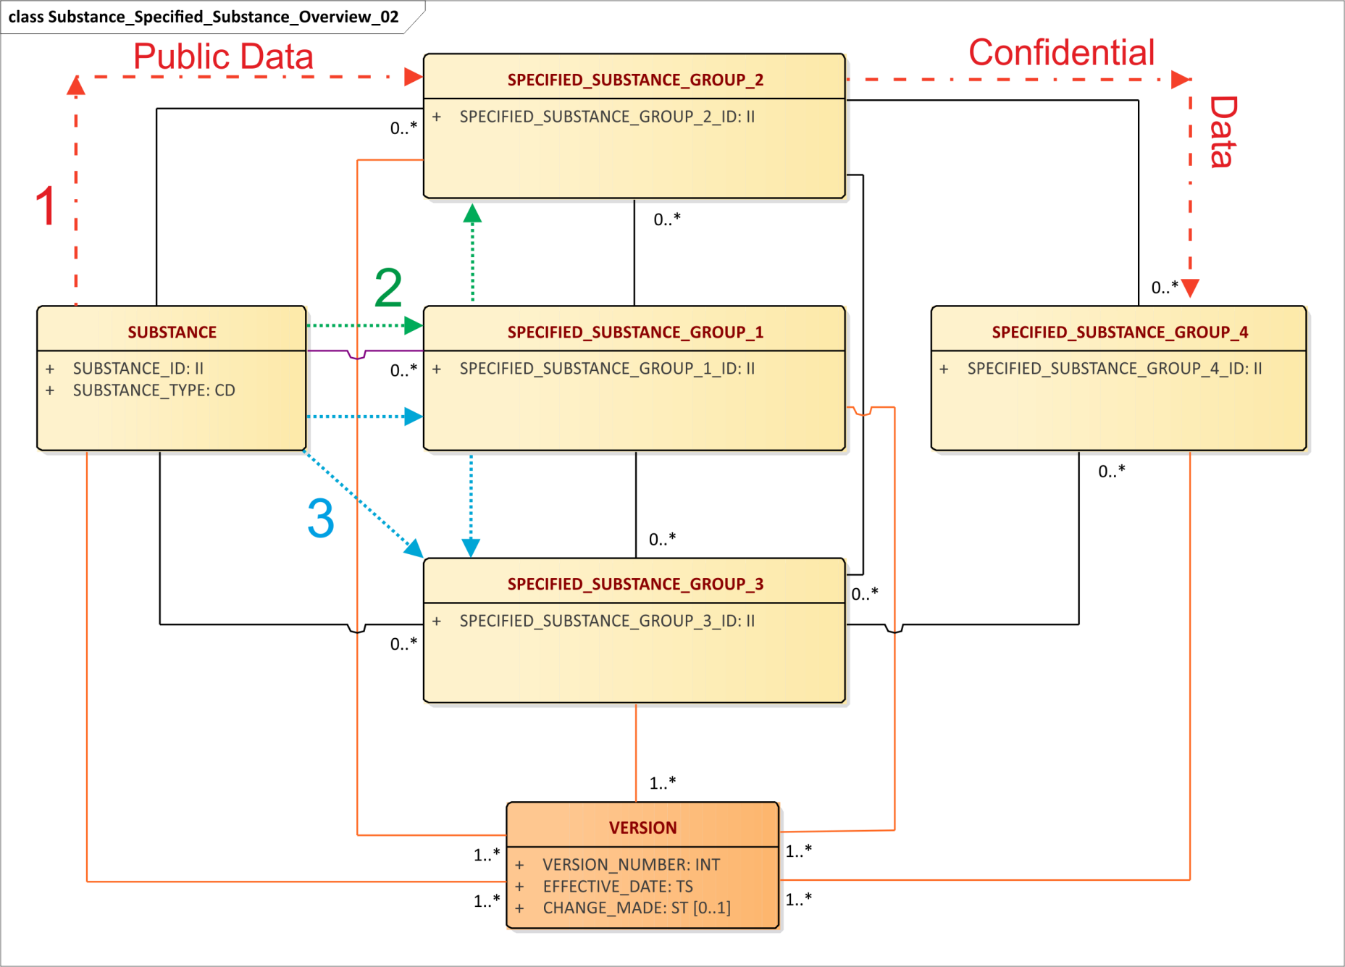
High-level Substance – Specified Substance (2) MAIN ROUTES
Notes:
Main routes of Substance – Specified Substance Relationships: 1) Substance – SSG2 information – SSG4 information; 2) Substance – SSG1 – SSG2 – SSG4 3) Substance – SSG3 or Substance – SSG1 – SSG3 (SSG4) information

Slide 12
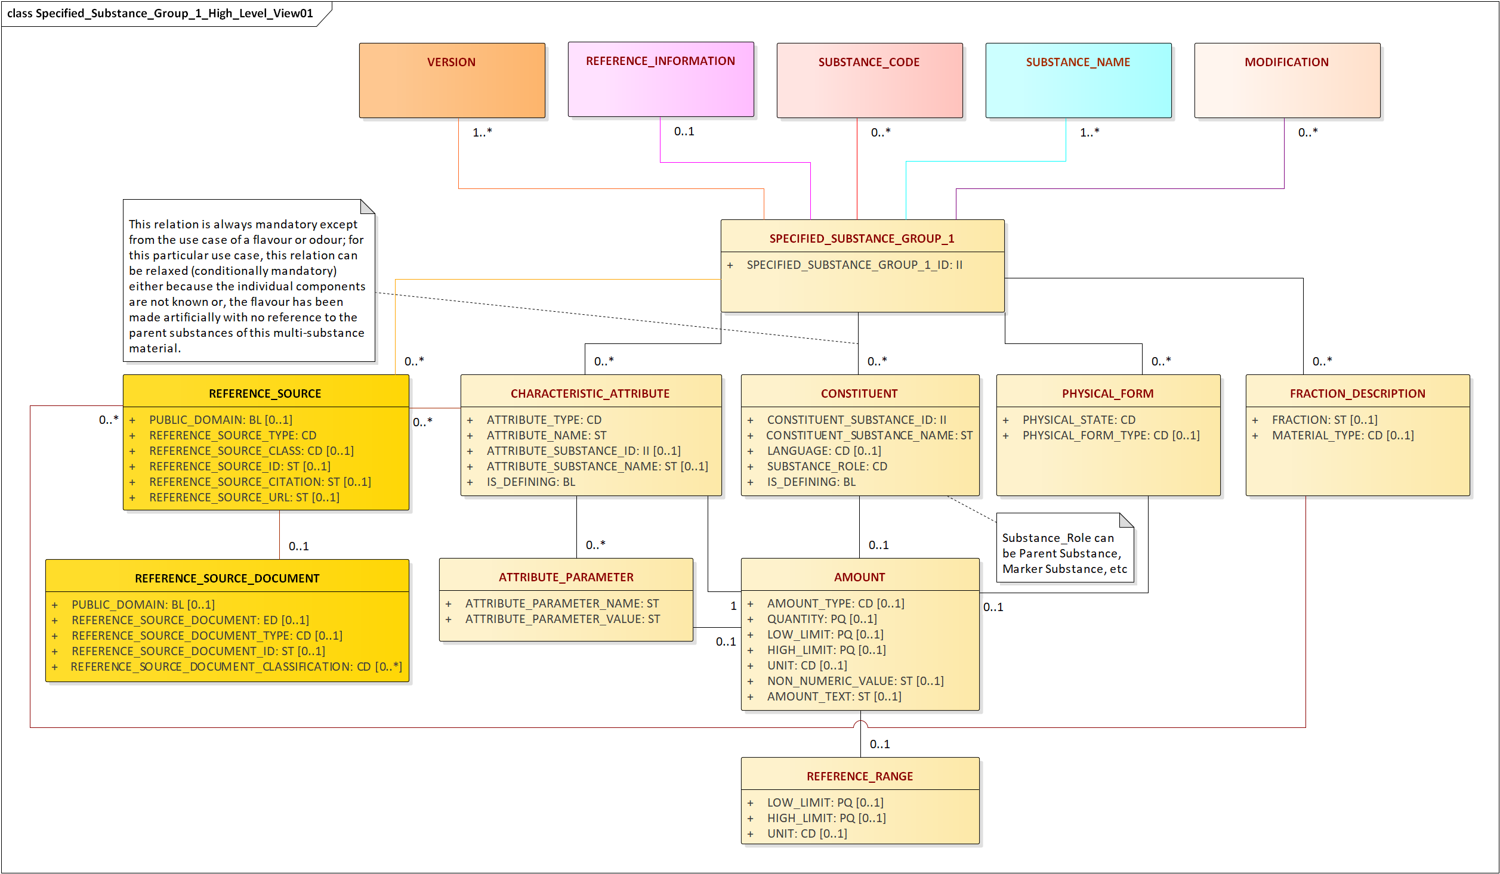
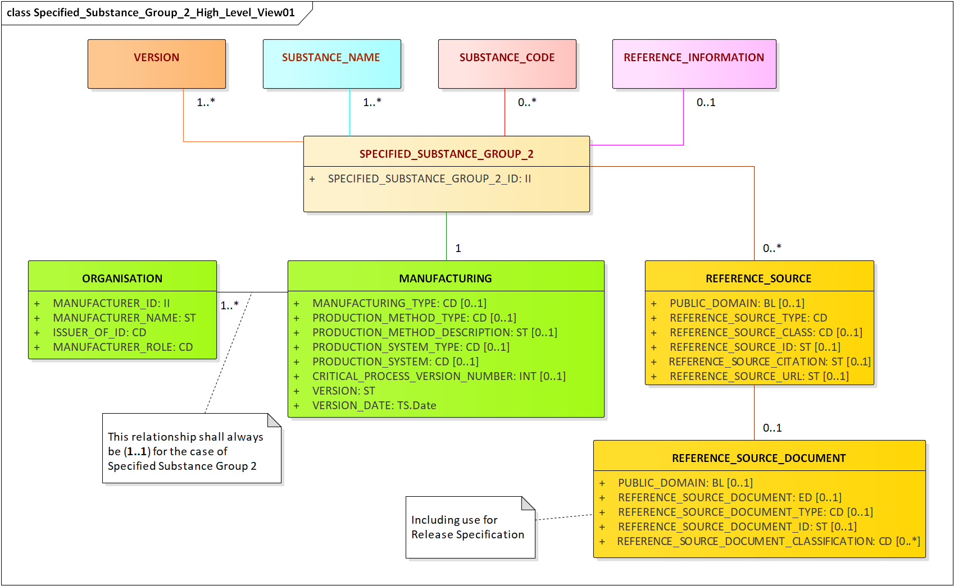
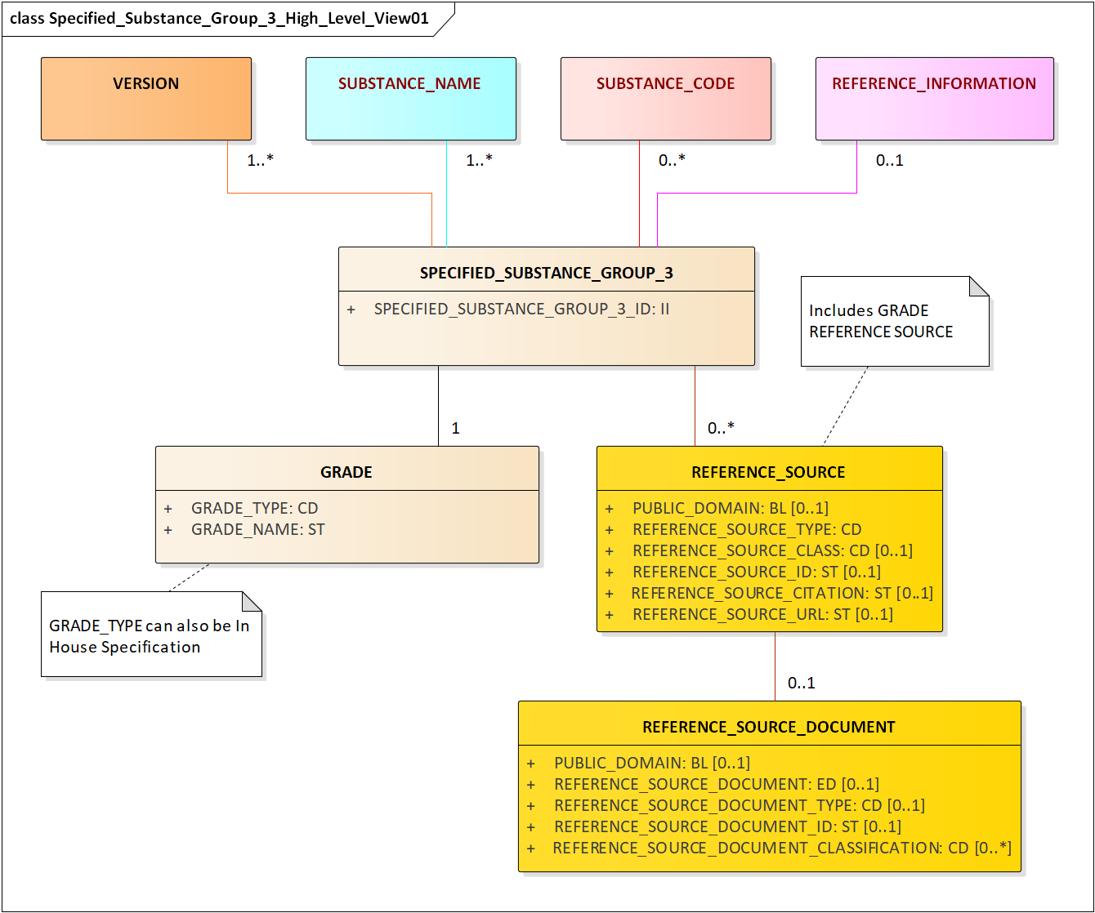
Spec. Subst G1,2,3
Notes:
Data elements of the Specified Substance Groups according to the Published ISO 11238 standard: SSG1- Data element group: Constituent, Physical form, Fraction and characteristic attribute (Properties, Particulars) description and relation to the modification group for specific modification description. SSG2 – Data element group: Organisation and high-level manufacturing description; SSG3 – Data element group: Grade Each Specified Substance Group is linked to Reference information

Slide 13
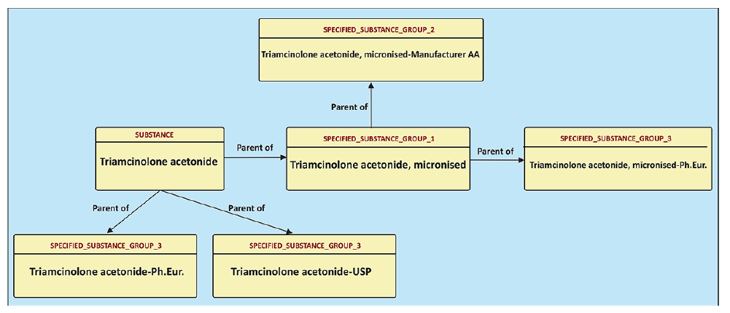
Substance and Specified Substance Groups ‘Parent’ relationships of Triamcinolone acetonide
Notes:
Substance and Specified Substance (s) ‘Parent’ relationship. Each following step is preceeded by the Parent step. Triamcinolone acetonide is the Parent of both Triamcinolone acetonide-Ph.Eur./-USP and Triamcinolone acetonide, micronised.

Slide 14
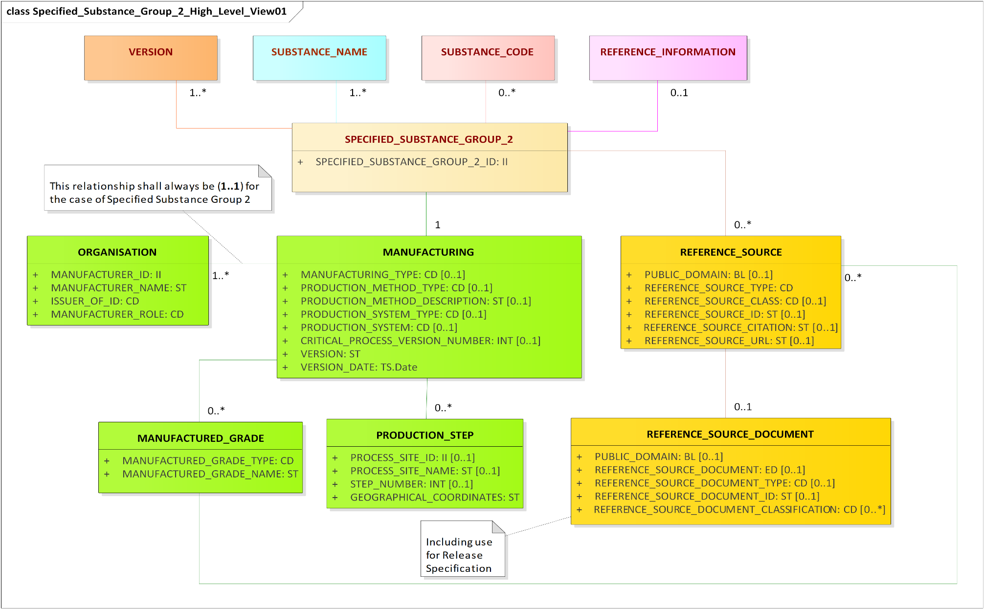
Update Specified Substance Group 2 proposed High-level Information
Notes:
The proposed Updated Specified Substance Group 2 includes the data element group ‘Grade’ to the high-level manufacturing information under the element group name ‘Manufactured_Grade’ . The advantage is that specifications of one substance or specified substance can be captured from several Pharmacopoeial/ In-House Grades, within one manufacturing process. This will reduce substantially the number of Specified Substance Group 3 Identifiers. In addition the element group ‘Production_Step’ is shifted from the ‘Extended’ view to the ‘High-Level’ view, which provides an easy description of the manufacturing process: Bulk production in Plant 1, Micronisation in Plant 2. The specification for the Particle size can be captured an In-House specification and laid down as a reference document.
The Polymorfic Form is laid down in the element group ‘Physical_Form’ at the Specified Substance Group 1 Information level

Slide 15
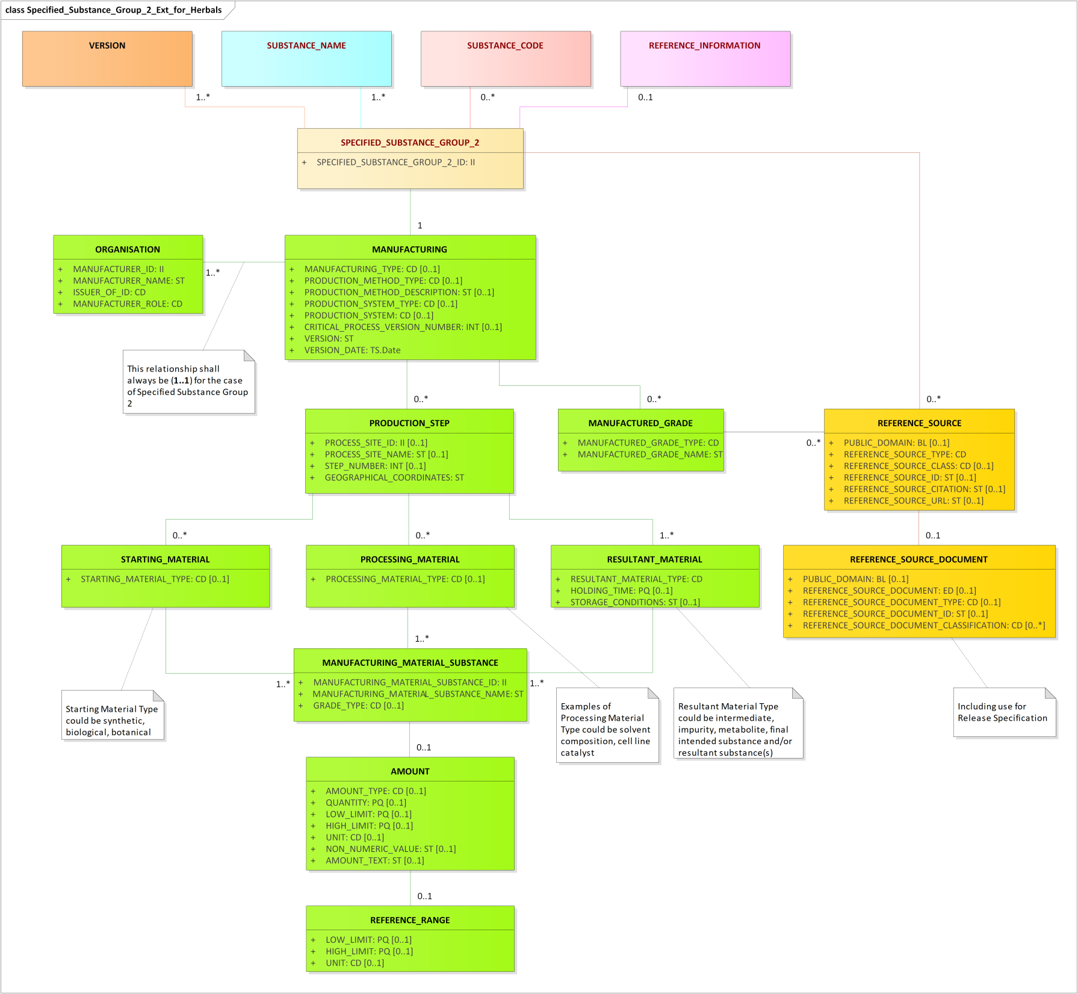
Proposed Update Specified Substance Group 2 Extended Information propModelSpecified Substance Group 2 High-level Information
Notes:
The Extended Specified Substance Group 2 Information level is updated accordingly.

Slide 16
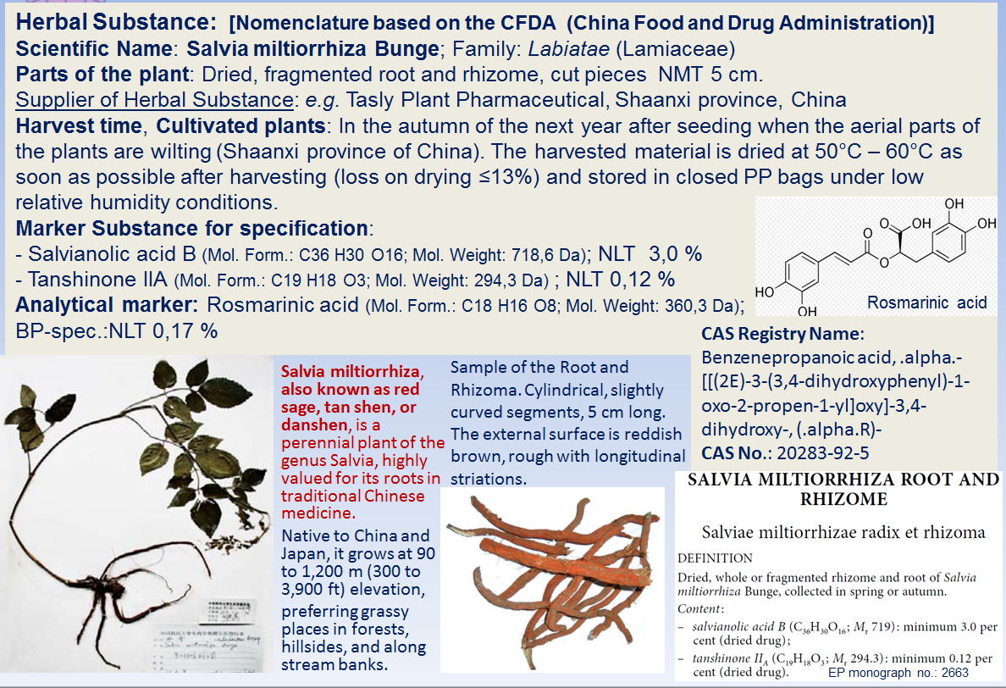
Herbal Substance information of Salvia miltiorrhiza, Rhizome and Root
Notes:
Example of Substance and Specified Substance Group 1 Information. Substance Information level: Source material information + Part (Salvia miltiorrhiza Bunge, Root and Rhizome, Dry. Specified Substance information: Harvest time and storage condition, Constituents specification, Analytical maker specification (Rosmarinic acid NLT 0,17)

Slide 17

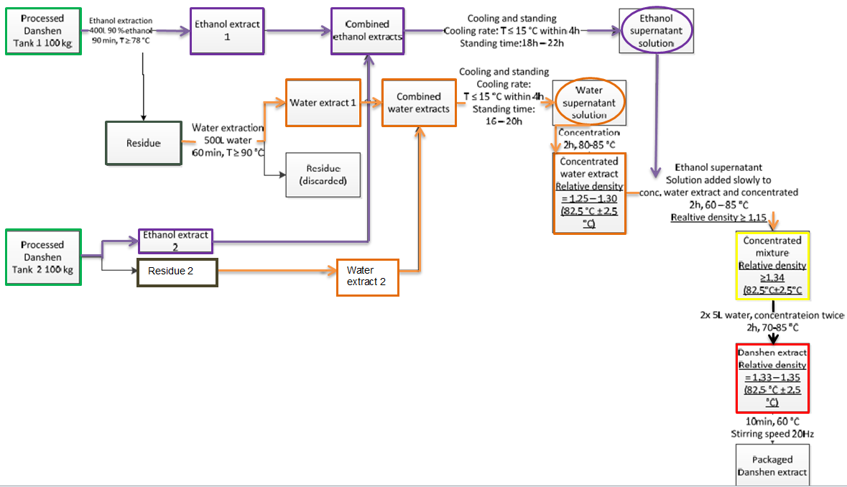
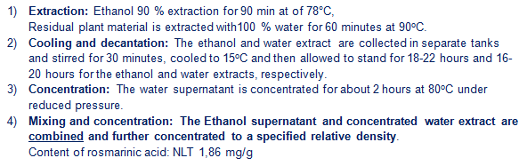
Formulation of a Traditional Herbal Medicinal Product,
e.g. Danshen Capsule (Cont. Salvia miltiorrhiza Radix Extract)
Herbal Preparation: Extract: Danshen extract is a brown to dark brown soft (semi-solid) extract, made through the
process of extraction and concentration (4,5 – 6 = 1). Name: Salvia miltiorrhiza root and rhizome Ethanolic (90 pCt.)-water liquid extract (4,5 – 6 = 1). DER: 4,5 – 6 Parts Herbal Substance = 1,0 Part Extract; Extraction solvent: Ethanol (90) – Water (10) = Ethanol 90 pCt. Manufacturer of Herbal Preparation: e.g. TXXXX, Pharmaceutical Group Co., Ltd, China
Notes:
Example of a two steps Extraction process: 1) Ethanol – water (90 – 10); 2) Extract of the residue: Water (100). On the end the two extracts are combined.

Slide 18
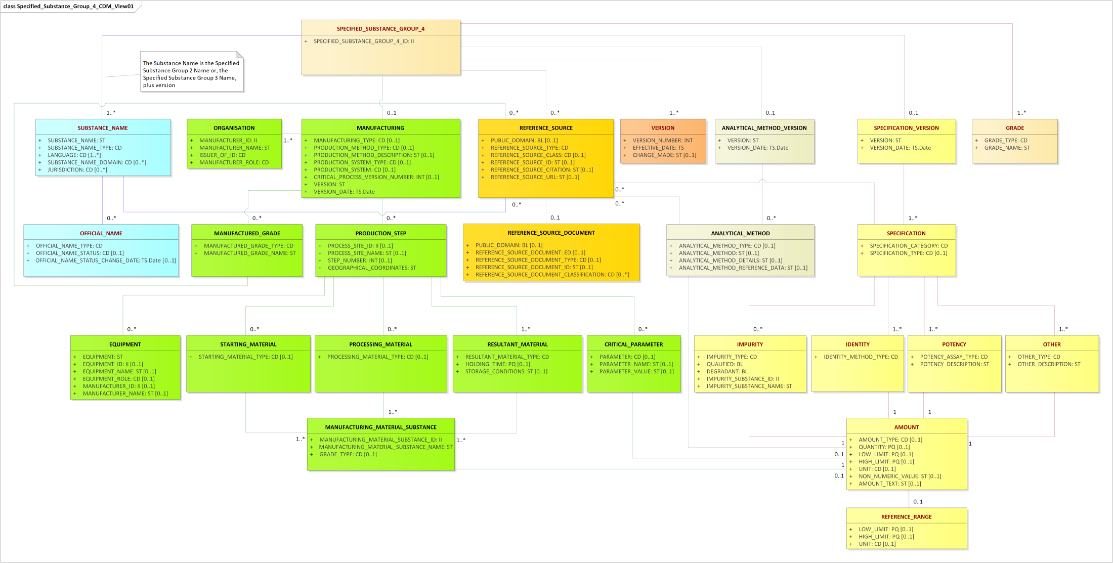
Proposed Update Specified Substance Group 4 Extended Information and ModelSpecified Substance Group 2 High-level Information
Notes:
Updated view of Specified Substance Group 4 in accordance with the update of data element group ‘Manufacturing’ as discussed in the previous slides

Slide 19

In Europe IDMP is an important part of the Telematics Roadmap
Security
European Telematics Cloud
Industry
Telematics portal
Agencies
Submission platform
Common systems
Hum specific
Vet specific
Industry systems
Workflow engine
Industry repositories
Integration engine
Other stake-holders
SPOR
Common repositories
Hum specific
Vet specific
Agency systems
Publishing engine
Agency repositories
Telematics DW & BI
protection
S= Identification of Ingredients; P= Identification medicinal products in accordance with EU Directives and Guidelines;
O= Names, address, Geographic location; R= List of terms (‘controlled vocabularies’) to describe product attributes
Notes:
In Europe the EMA is using Mater Data management: SPOR S= Identification of Ingredients; P= Identification medicinal products in accordance with EU Directives and Guidelines;
O= Names, address, Geographic location; R= List of terms (‘controlled vocabularies’) to describe product attributes

Slide 20
Why and What?
Why?
There is no EU wide list of substances of adequate quality for use in regulatory use cases, leading to errors in submissions, rework by assessors and duplication of substance expert work across the network.
What?
This project proposes to install an EU Network wide substances database (based on IDMP standards), governed by a group of NCA substance experts (=Substance Validation Group), who ensure data quality is fit for use.

Slide 21
Outcome of the EU-SRS Project
25

Slide 22
Role of EU-SRS
SMS
Part of EMA SPOR
Management of ID’s
EU-SRS
Delivered by MEB/EMA
Detailed substance ID mgt (IDMP)
Align ID’s
Alignment &
Global IDs
FDA-SRS
Delivered by FDA
In the first Iteration EU-SRS database will focus on structurally diverse substances:
Vaccines
Biologicals (e.g.monoclonal antibodies, plasma-derived substances)
Herbals
Homeopathics
Allergens
EU-SRS will complement SMS on these substances

Slide 23
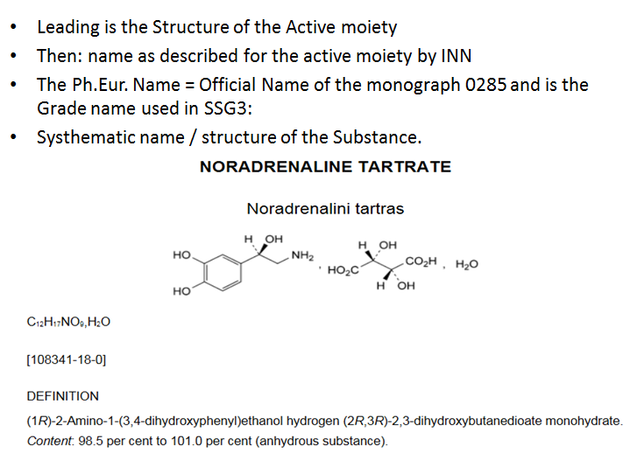
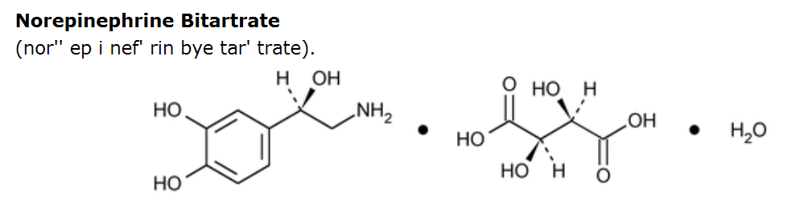
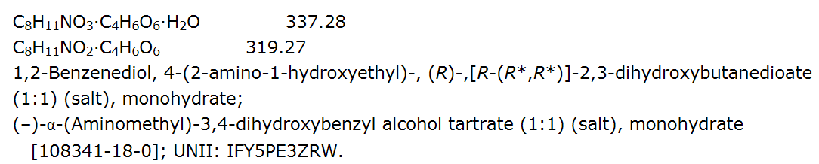
Preferred Name
Substance name are ambiguous: Example Norepinephrine tartrate
Norepinephrine (INN)
Noradrenaline tatrate (Ph.Eur.)
Norepinephrine bitartrate (USP)
Preferred name: Norepinephrine hydrogen tatrate monohydrate
The USP Name = Official Name of the monograph and is the Grade name for SSG3
Notes:
The Preferred name is dominant name coupled to the Substance/ Specified Substance ID. For Chemicals the structure is leading, then the INN, then Monograph name, then Systhematic name as described by an official name source. In some occasions the brand name is helpful next to the common name e.g. Polymer substance.

Slide 24
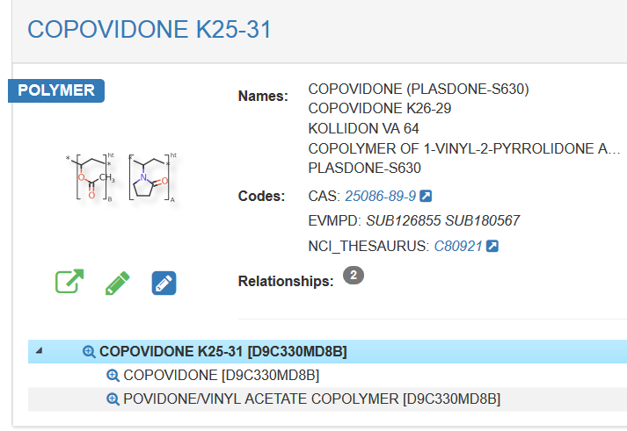
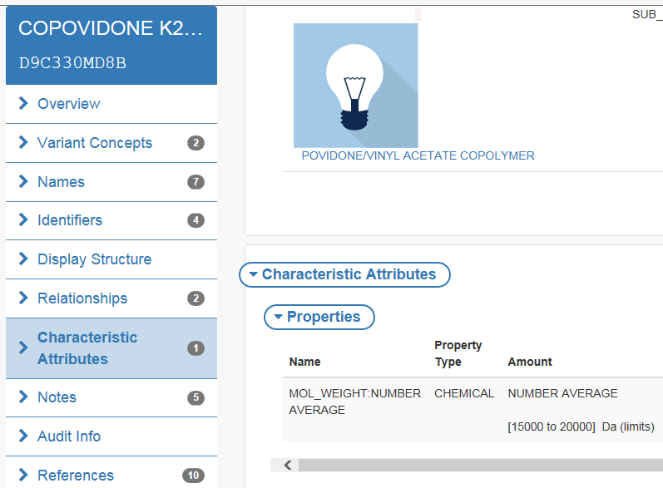
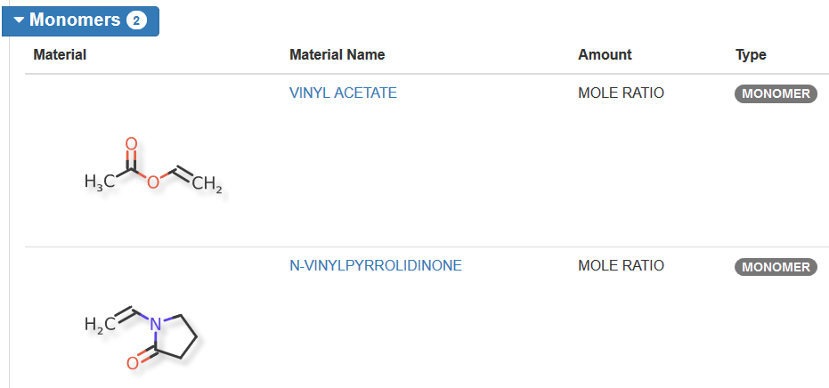
COPOLYMER OF 1-VINYL-2-PYRROLIDONE AND VINYL ACETATE IN THE MASS PROPORTION OF 3:2 (MW=40000)
Complete defined properties for mass ratio between monomers and molecular weight (Mw) indicated by the display of the navigation column in the substance record
Monomer and Mw are defining elements for Polymer
Notes:
Characterising data elements for the common name: Structure. name and ratio of the monomers, molecular weight (range), viscosity.

Slide 25
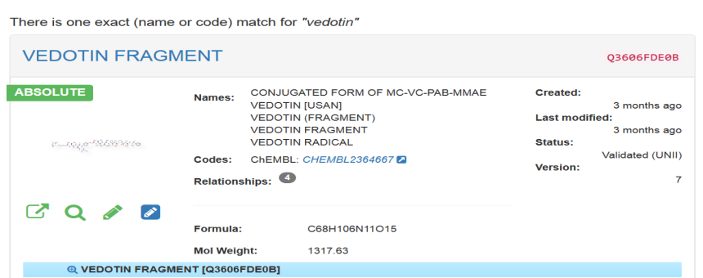
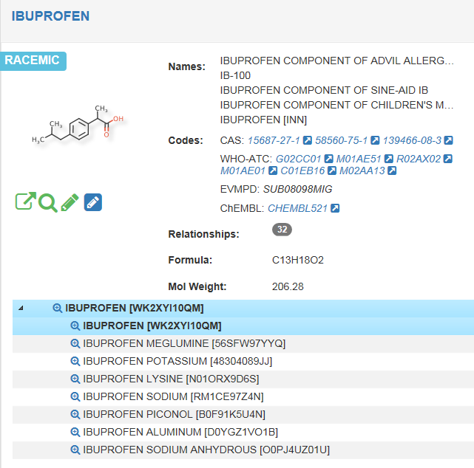
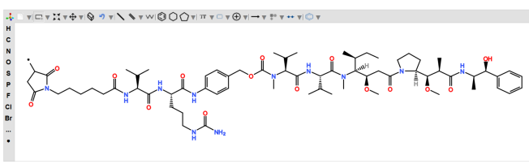
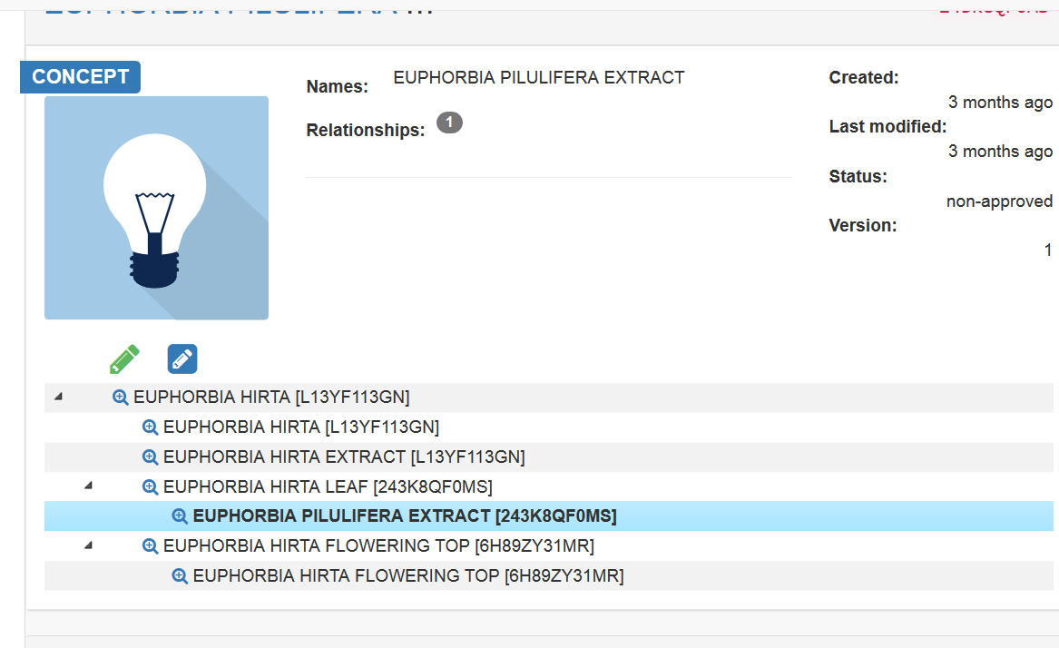
EU-SRS Preview
Links to Structure/search details
Links to sources and other codes
Hierarchy to related substances
List of substances
Notes:
Hierarchy active moiety – salt/ hydrate/ salt-hydrate relationship, pre-registration of covalent fragments (Vedotin fragmment)

Slide 26
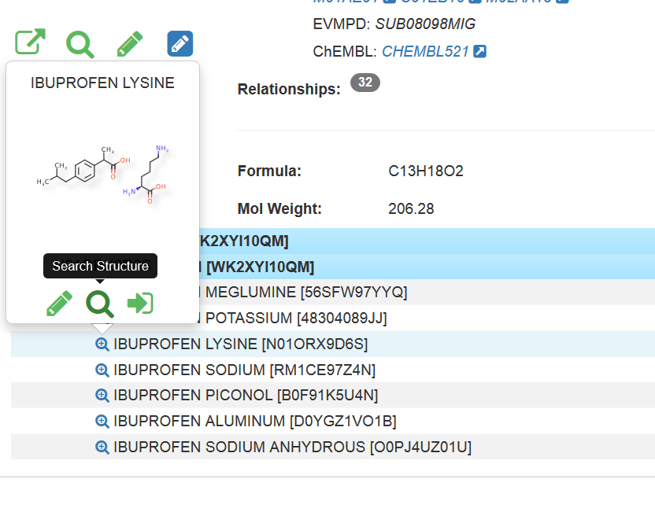
EU-SRS preview: Use of hierarchy for selection/ Parent-Child relationship
Select the correct Preferred term by direct name/ID and Structure display
Notes:
Hierarchy is used in order to select the proper substance and validation of the selection by instant structure information.

Slide 27

Support the health care domain
Structure/relational substance
data base
GInAS Project/
G-SRS Software
Name/ Text
substance data base

Slide 28
Thank you for your attention
Ciska Matai (cg.matai@cbg-meb.nl) Herman Diederik (h.diederik@cbg-meb.nl) Medicines Evaluation Board, The Netherlands * Postal address: P.O. Box 8275 , 3503 RG Utrecht, The Netherlands * Visitors address: Graadt van Roggenweg 500, 3531 AH Utrecht, The Netherlands * Mobile: +31(0) 6 52 75 63 60

